Slide 1
Predicting NHL Outcomes via ML
Neural Networks vs Logistic Regression
Anar, Jodhan, Bryce, Noah, Tommy, Evan

Slide 2

Problem Description
Goal: predict outcomes of NHL games using prior/current statistics of the two opposing teams.
Purpose: assist gambling industry
Threshold: For results to be considered statistically significant, average result success needs to perform better than chance (50%)

Slide 3
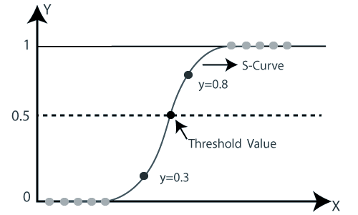
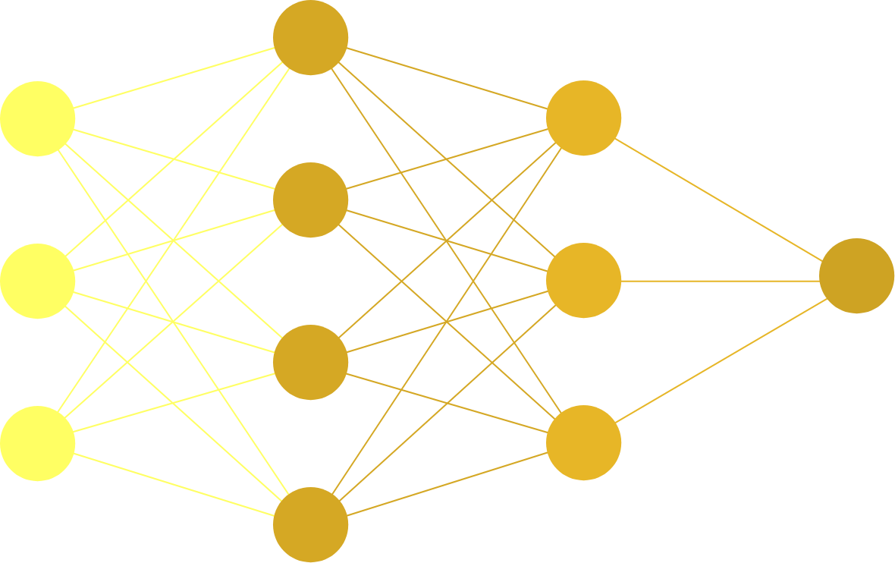
Logistic Regression
Not used in the studies we looked at for NHL, only NFL study
Much simpler than a multilayer neural network and performs well when data is linearly separable.
Neural Network
In our observed studies, Neural Networks were the best-performing method of classification for both solo and team sports
General purpose method that is also very complex in nature
Neural Network
In our observed studies, Neural Networks were the best-performing method of classification for both solo and team sports
General purpose method that is also very complex in nature

Slide 4
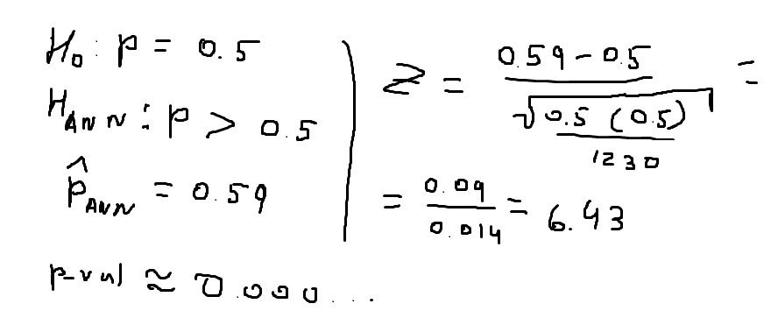
Existing Studies
J. Weissbock (n.d.)
“Use of Performance Metrics to Forecast Success in the National Hockey League”
Abstract:
Concluded that between Neural Networks and Support Vector machines, Neural Networks were most accurate at 59.38%
However, logistic regression was never explored in this study and the data used was a smaller sample than what we used
S. Bouzianis (2019)
“Predicting the Outcome of NFL Games Using Logistic Regression”
Abstract:
Found Logistic Regression to be up to 70% accurate at predicting the outcomes of games
While Log-Reg seems more promising than Neural Networks based solely on this study, football has more measurable events than hockey and is thus more likely to be predicted accurately
Notes:
J. Weissbock:
Used simple metrics such as Goal Differential, and Shot/ Save %
Also used more sophisticated stats like Fenwick Close % (puck possession), and PDO (luck)
S. Bouzianis
Used similar metrics to the NHL study such as Points For and Points Against
However, also used metric idiosyncratic to football such as Rushing Yards and Passing Yards

Slide 5

Data Collection and Usage
Step 1
Step 2
Step 3
Seasonal game logs for each team were collected from a third-party statistics website (quanthockey.com) as Excel sheets. Statistics included date, location, outcome, goals, shots, faceoffs and saves.
We built a parser to process each game from each team and collect a team’s statistics up until a given point in the season. This allowed us to look any team’s performance at any point throughout the year.
Individual game statistics and outcomes were all appended to a pandas dataframe to be used as input data for our classification methods.

Slide 6
Neural Networks

Slide 7
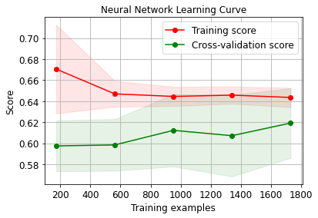
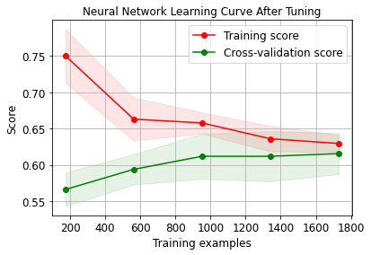
Training
Before Hypertuning
Train Accuracy: 0.659734257654535
Test Accuracy: 0.605080831408776
After Hypertuning
Train Accuracy: 0.6320046216060081
Test Accuracy: 0.6235565819861432

Slide 8
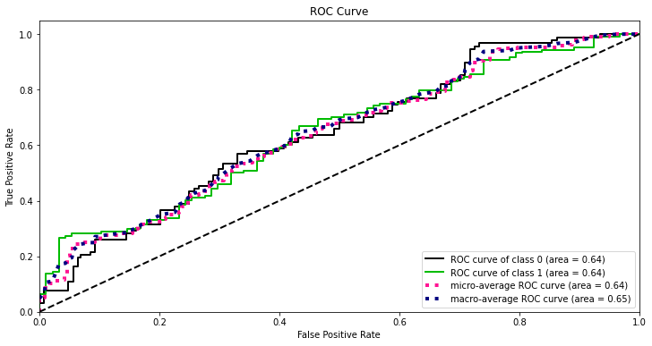
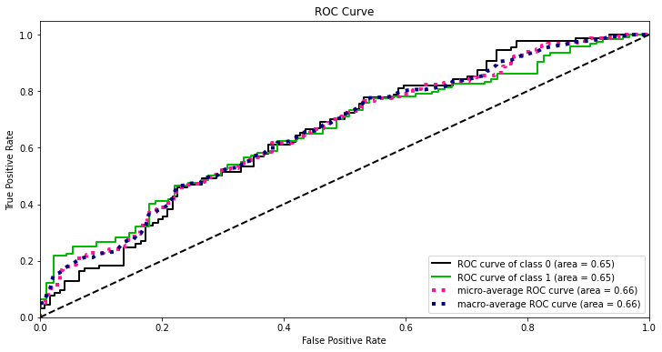
Training
Notes:
The higher the AUC, the better the performance of the model at distinguishing between the positive and negative classes.

Slide 9
Logistic Regression

Slide 10
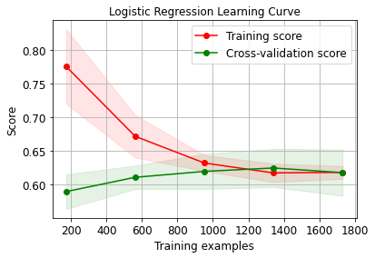
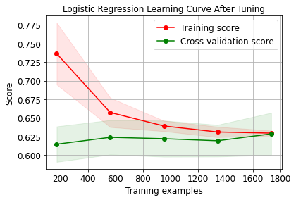
Logistic Regression Learning Curves
Before Hyperparameter Tuning:
Train Accuracy: 0.6239168110918544
Test Accuracy: 0.628175519630485
After Hyperparameter Tuning:
Train Accuracy: 0.634315424610052
Test Accuracy: 0.6327944572748267
Notes:
The figure on the left was before we hypertuned the Logistic Regression, it shows that our data was underfitting. Afterwards we used GridSearchCV and Kfold cross validation to find the optimal parameters for the Logistic Regression.

Slide 11
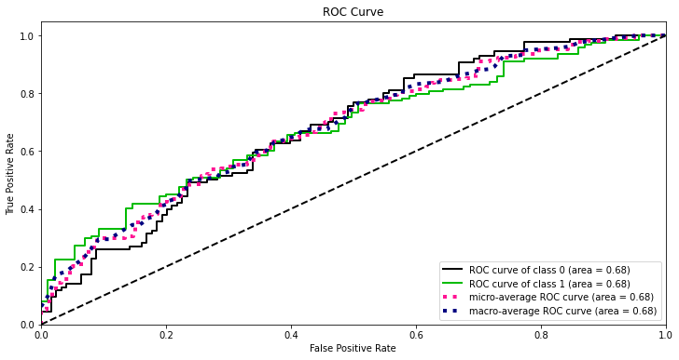
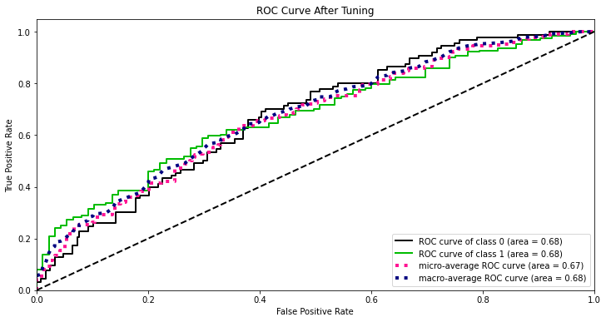
ROC Curves

Slide 12
K-fold Validation and Hyperparameter Tuning
We would have nested for-loops to go through the variety of the parameters.
For each set of params we used K-fold cross validation.
We set K=5 to get a recommended 80/20 split for train/validation sets.
Then we will test our parameters on the 5 folds below ad and calculate the average accuracy.
After iterating through the multitude of parameters, the best ones were selected.
Train | Train | Validation | Train | Train

Slide 13
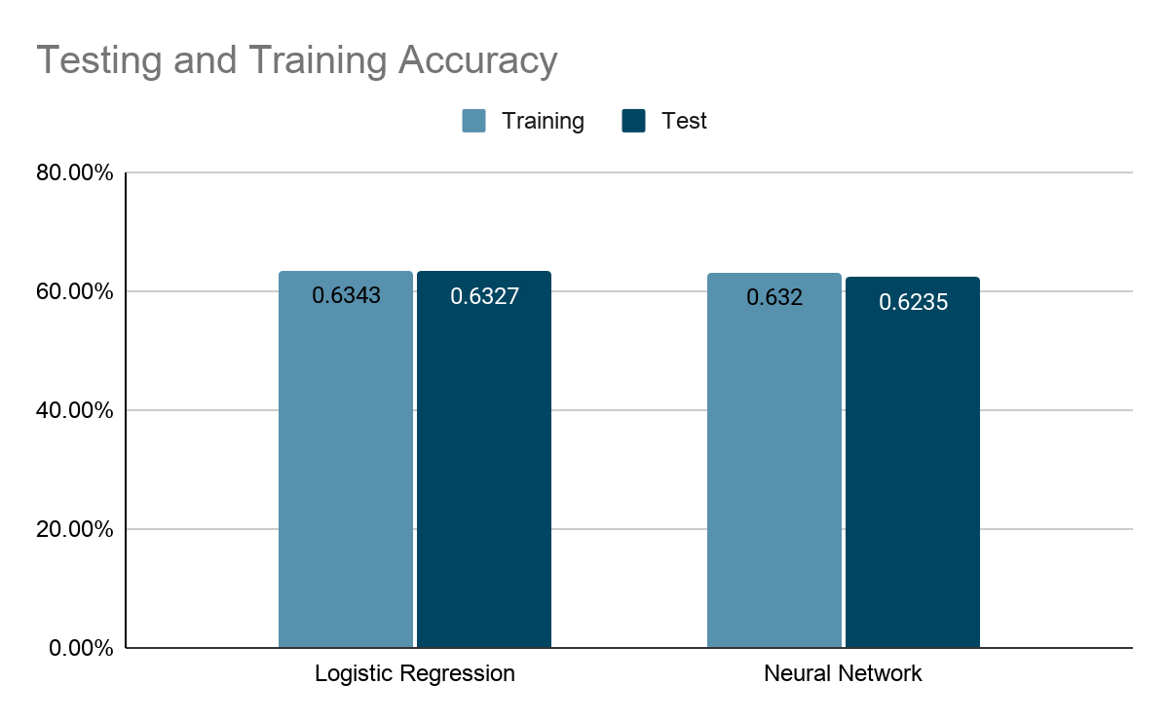
Neural Network Vs Logistic Regression
Findings
After tuning hyperparameters for both methods, we concluded that Logistic Regression had a slight edge for both training and testing accuracy
35
25
22

Slide 14
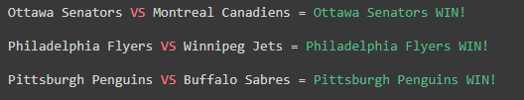
Conclusion
With 63.3% test accuracy, Logistic Regression had the most successful results. It is 13.3% above the expected guessing likelihood, which makes it very statistically significant. Neural Network got 61.2% on test accuracy.
Utilizing a binomial cumulative distribution, we are 99.2% confident of at least breaking even when betting on every game a team plays through a season with our logistic regression algorithm.
Below are three example predictions that the system made.

Slide 15
Limitations
Data size limitations. We only trained the data on one season. Thus, we cannot be entirely confident our 63.3% accuracy result would hold through other seasons.
Uncontrollable variables. Example: A strong player getting injured is not reflected in the data.
Unreliability of initial training data. Initially the training is done based on small data samples which can lead to inaccuracies in early stages of learning. The weight of the first game has equivalent weight to the last game, despite these drawbacks.
Notes:
From the Weissbock study (on more abstract, “experimental” measurements):
“These included Fenwick Close % (a statistic of possession which adds up the total shots, missed shots, and goals for and against); PDO, a statistic of luck; and 5-on-5 Goals For and Against ratio. These statistics are not as readily available and there is no historic record of them. It is only possible to find their current values on websites such as www.behindthenet.ca. Daily work was required to make sure they were collected properly, otherwise the work required to recover their values would be enormous.”
Other limitations
Injuries of major players
Fatigue of players from travel (something Tommy brought up in the proposal)

